Slide 1
COLLEGE INFORMATION NIGHT
2017-2018
Linda Hacker
College and Career Counselor
Newsome High School

Slide 2
Edsby
Newsome Home page
Join Groups
“Class of 2019”
“Class of 2020”
“Community Service”
“Scholarships”

Slide 3
Remind
Text 81010
Message: @n2019
                @n2020a
Email
http://newsome.mysdhc.org
> Resources > Guidance

Slide 4
CALCULATE ACADEMIC GPA
College GPA based on 19 academic credits
Bright Futures Program based on 16 academic credits
Each group applies their own weighting system for Honors, AP and Dual Enrollment

Slide 5
Understanding the GPA
District GPA- Weighted cumulative GPA
-including weight for honors .04, AP .08, and Dual Enrollment .08) classes
-Used to determine class rank
State GPA- Un-weighted cumulative GPA
Bright Futures GPA- Recalculates using the core academic unites ( .50 honors, AP, Dual)
-best attempt at the 16 units.
College Recalculation of the GPA- Varies
( some give .50 honors, 1 AP and Dual)

Slide 6
PSAT INFORMATION
Juniors and Sophomores
Mean Score –
Newsome District State
1051 943 982 11th grade
993 898 895 10th grade
Section Index Score
Qualifying Score for 2017
219

Slide 7
PSAT
Scholarships & Recognition (National Merit)
By taking the PSAT/NMSQT, you may qualify to enter the competitions for prestigious scholarships and participate in recognition programs. (Selection Index)
Personalized feedback, practice and college planning based on your PSAT/NMSQT results.

Slide 8

Khan Academy

Slide 9
FREE SAT
March 7, 2018
Who: All Juniors
Where: During school on March 7, 2018
When: Normal school hours (start 7:30 am)
Students will receive information in homerooms
Students must create a College Board account at Collegeboard.com. If you have an account do not make another!
District will bulk register students

Slide 10
REGISTER FOR THE SAT/ACT
SAT
Fee: $46.00 (optional writing $60.00)
Writing = Multiple-choice/essay
Critical Reading = Analogies Eliminated
Math = Quantitative Comp. Eliminated
Free SAT for Juniors March 7,2018
ACT
Fee: $46.00 (Optional writing $62.50)
Writing is required by most Colleges and Universities
English Math
Reading Science
NCAA #9999 (information in packet)

Slide 11
Programming
Students will be programming by English classes
Rigorous classes
Full schedules
Dropping classes
FLVS (Directions in packet)
Dual Enrollment (ENC 1101 on campus next year)
  Meet required GPA 3.0 unweighted and test scores (in packet)
OJT
Healthy Balance!

Slide 12
Advance Placement vs Dual Enrollment
Both weighted the same .08
AP prepares students to pass an exam to prove their mastery of college-level curriculum. Dual credit in effect enrolls students in college courses while they are still in high school, allowing them to earn credit for both.
Students in AP classes, for example, may find that although they passed an exam, their score isn’t high enough. At some elite colleges, even the highest mark doesn’t count.
And while dual credit offers students a transcript proving they completed a course, it may be a transcript some colleges do not accept.

Slide 13
The quality of dual credit courses can be difficult to measure.
AP Coures,In contrast, can be judged on a more consistent standard — the national exam.
“It really depends on the individual student’s circumstances,”
******Dual Enrollment starts your College GPA*****

Slide 14


College Search Tools
College Board
Big Future
College Search
Career Information
Choices
College Prowler.com
Cappex.com
School Websites

Slide 15
Floridashines.org
Explore Colleges & Universities
Discover Degree Programs
Know the Admission Requirements
Take an Affordable Path to a Degree
Earn College Credit in High School
Get Ready for College
Pay for College
https://www.floridashines.org/find-a-career/mycareershines

Slide 16
BigFuture
ASSISTANCE FOR INDIVIDUALS NEEDING TO MEET HIGH SCHOOL GRADUATION REQUIREMENTS
CAREER PLANNING
INFORMATION ABOUT CAREER TRAINING
GENERAL FINANCIAL AID INFORMATION
REFFERRAL TO CAMPUS OR COMMUNITY RESOURCE
PREPARATION
https://bigfuture.collegeboard.org/

Slide 17
NACAC National College Fairs
March 18,2018
Tampa Convention Center
12 p. m. -3 P.M.
Register at www.nacacfairs.org/NCF

Slide 18




COLLEGE OPTIONS
University
    Public
    Private
  In state/Out of State
Community College
Honors Program
    Separate applications
Technical Program

Slide 19
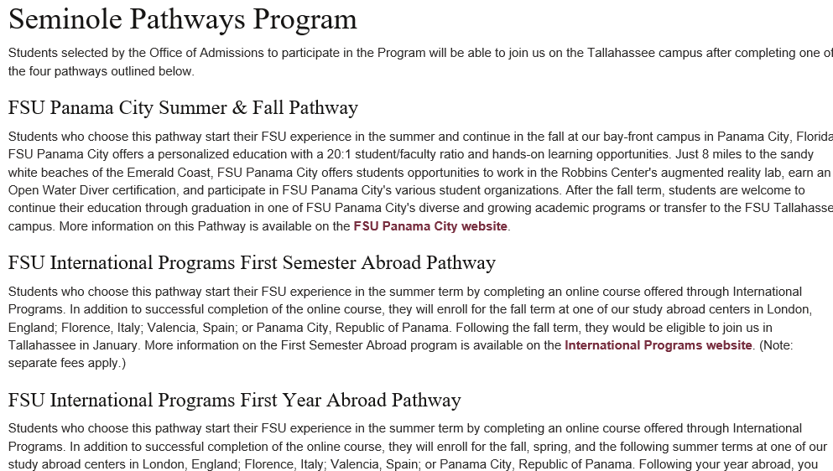
FSU Seminole Program

Slide 20
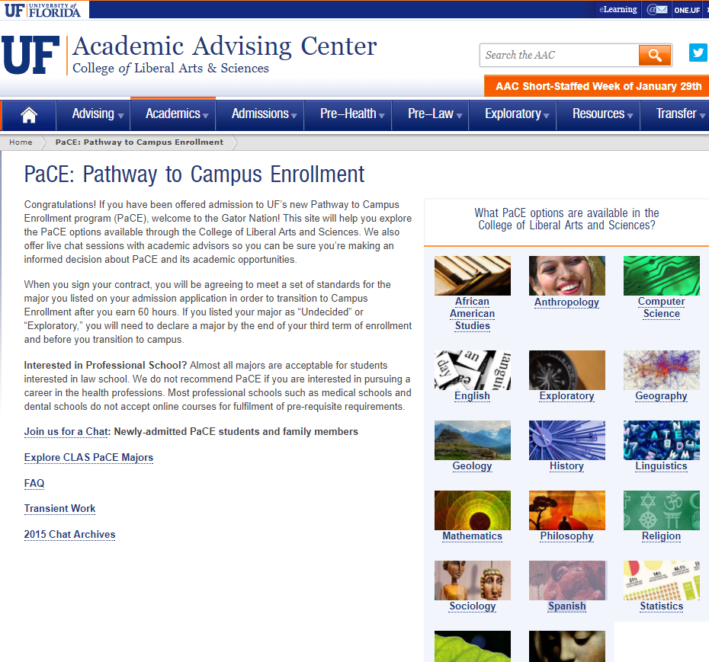
University of Florida PaCE Program

Slide 21
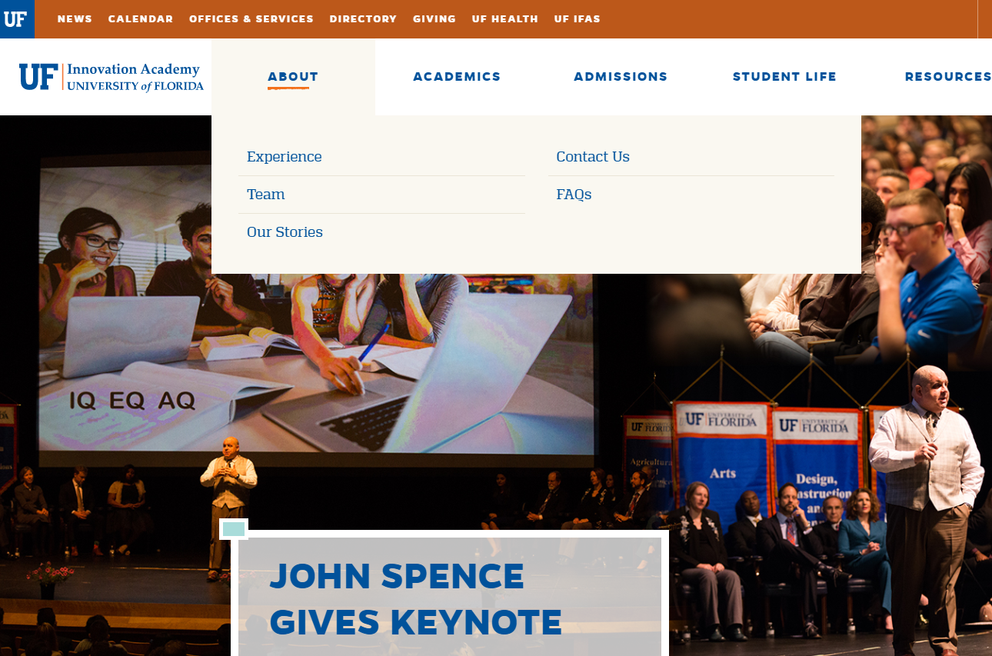
UF Innovation Academy

Slide 22
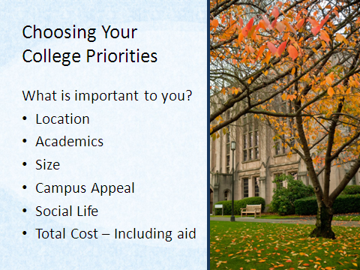

Slide 23
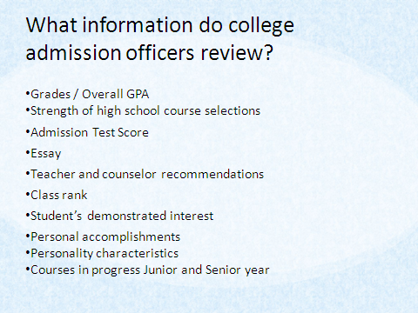

Slide 24
Recommendations- Brag Sheet
Who should write it?
Teacher
Community Leaders
Counselors
Work supervisors
What the letter should say
How the student should request the letter (resume, brag sheet) copies in packet
Thank you letters from students
Allow 2 week turn around time

Slide 25

Student Essay Writing
College Essay
Does the college require an essay
Essay Question
What is the essay telling the reader about the student
Scholarship Essay
Possibly use college admission essay
Make sure the student is writing and answering the question that is being asked.

Slide 26
VISIT SCHOOLS
Step on campus
Talk to students on campus
Eat on campus
Check out colleges with in the university for your major
Tools to help
College Application Tracker
College Application Materials Checklist
Top Questions to Guide you to the Perfect College

Slide 27
Community Service Guidelines
Proposal must be approved by guidance before volunteer work can begin.
No approval –No Bright Futures!!!!!!
Forms in guidance and Newsome Web-site
Not a check off list for college application
Application must be complete!

Slide 28
Social Issues
Health- “My social issue is Health and my goal is to educate and assist the community with health issues.”
Others:
  Abuse
  Elderly Citizens
  Mentally/Physically Challenged Issues
  Mentoring and Tutoring Students
  Poverty
  Enviromental

Slide 29
Record of Community Service Hours

Slide 30
Bright Futures Scholarship
Florida Academic Scholarship
Florida Medallion Scholarship
Florida Gold Seal Scholarship

Slide 31
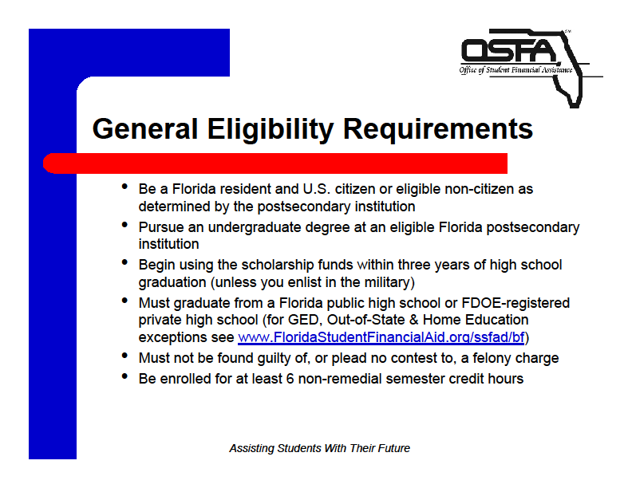

Slide 32
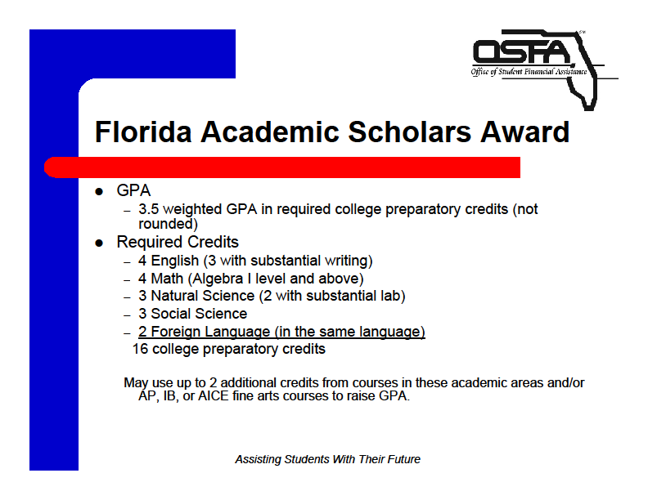

Slide 33
FLORIDA ACADEMIC SCHOLARS AWARD
Community Service
100 hours-preapproved by the high school
Test Scores
1290 SAT Reasoning Test or 29 ACT
Writing sections not used in the composite
Deadlines (test taken by)
January 31 for mid-year (7th semester ) eligibility
June 30 for final (8th semester) eligibility
ACT scores rounded up for score with .5 and higher
SAT Subject Test Not used
GPA
3.5 GPA recalculated

Slide 34


Slide 35
FLORIDA MEDALLION SCHOLARS AWARD
Community Service
75 hours-preapproved by the high school
Test Scores
1170 SAT Reasoning Test or 26 ACT
Writing sections not used in the composite
Deadlines (test taken by)
January 31 for mid-year (7th semester ) eligibility
June 30 for final (8th semester) eligibility
ACT scores rounded up for score with .5 and higher
SAT Subject Test Not used
GPA
3.0 GPA recalculated

Slide 36
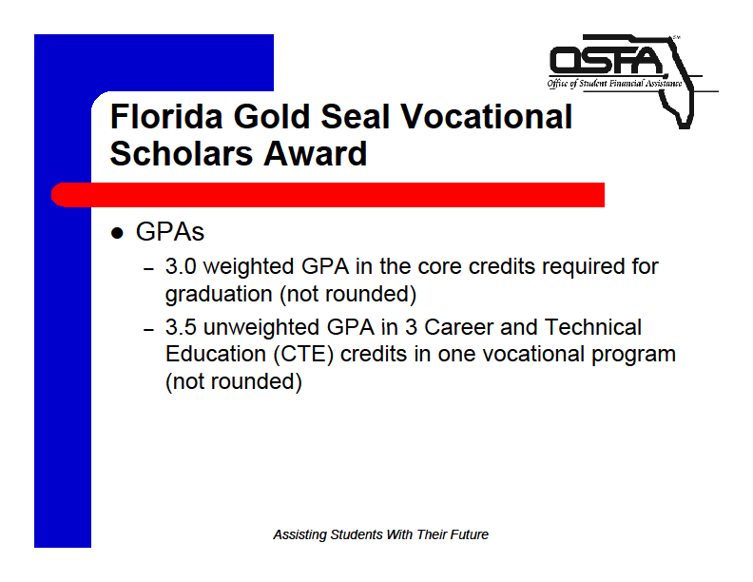

Slide 37
Florida Gold Seal Scholars Award
Vocational School/Certified Programs
Community Service
30 hours- preapproved by the high school
•SAT Reasoning Test:
440-Critical Reading
440-Math 440
•ACT:
17-English
18-Reading
19-Math
•PERT:
104-Reading
99 - Writing
113-Math

Slide 38
Scholarship & Financial Aid
Categories of Scholarships
Local
National
School specific
Apps available through out year
FAFSA (Grants/Loans)- January 1st
Hillsborough County Financial Aid Nights (November & December)
EDSBY SCHOLARSHIP GROUP

Slide 39
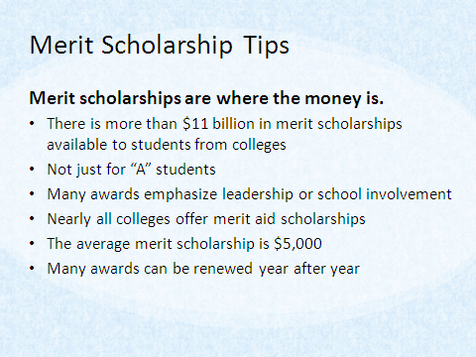

Slide 40
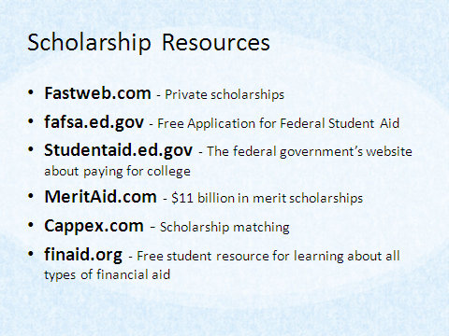

Slide 41
FAFSA
FAFSA.gov
Free Application for Federal Student Aid
Available October 2016
Complete Taxes Early!
Federal Student Aid programs
  www.student aid.ed.gov
  1-800-4-FED-AID

Slide 42
Next Steps
In School
Stay focused on academics
Do not lighten your academic load for senior year
Meet with your school counselor
Stay involved in school activities
Standardized Testing
Prepare for PSAT
Prepare for and register for ACT / SAT tests
Register for AP tests as appropriate
College Exploration
Explore colleges on the Web
Visit colleges if you can
Meet with college representatives
Attend college fairs

Slide 43
WATCH OUT FOR SCAMS!!
Information Should Be FREE, Yes FREE
Do Not Pay Any Money For Information
See Ms. Hacker first !!!

Slide 44
QUESTIONS?

